Slide 1
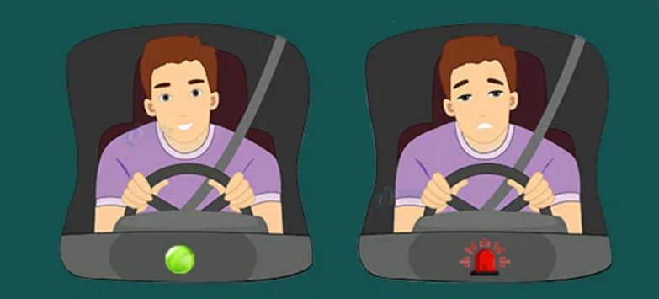
Driver Drowsiness Detection using deep learning
Drowsiness is the primary cause of road accidents and data science can address it (DataFlair.com)
GREGORY EKE
202131012

Slide 2
Related research
Rajkar, A., Kulkarni, N., Raut, A. (2022). Driver Drowsiness Detection Using Deep Learning. In: Iyer, B., Ghosh, D., Balas, V.E. (eds) Applied Information Processing Systems . Advances in Intelligent Systems and Computing, vol 1354. Springer, Singapore. https://doi.org/10.1007/978-981-16-2008-9_7
Primary cause of accidents all over the world
Face and Eye regions image processing using Convolutional Neural Networks (CNN)
Tanveer, M. A., Khan, M. J., Qureshi, M. J., Naseer, N., & Hong, K. S. (2019). Enhanced Drowsiness Detection Using Deep Learning: An fNIRS Study. IEEE Access, 7, 137920-137929.
Deep Neural Networks (DNN) to classify drowsy and alert states
CNN on colour map images to determine brain activity detection
Kumar, V., Sharma, S. & Ranjeet Driver drowsiness detection using modified deep learning architecture. Evol. Intel. (2022). https://doi.org/10.1007/s12065-022-00743-w
Hybrid Deep Learning model using modified InceptionV3 and Long short-term memory (LSTM) network
Mouth and Eye regions extracted from video frame

Slide 3
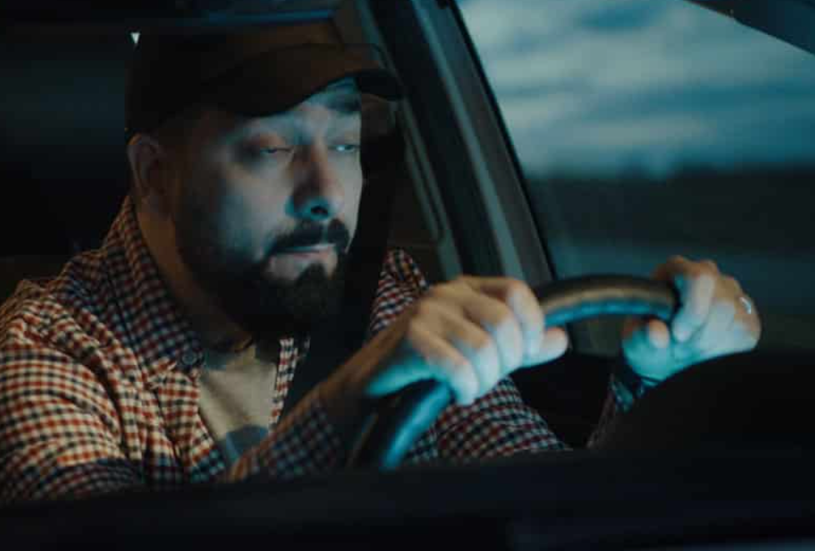
Aims
Creating a system for detecting driver drowsiness using deep learning techniques.
Assessing system performance precisely and effectively identifying drowsiness.
Alerting drivers before they get drowsy, hence, improving road safety.

Slide 4
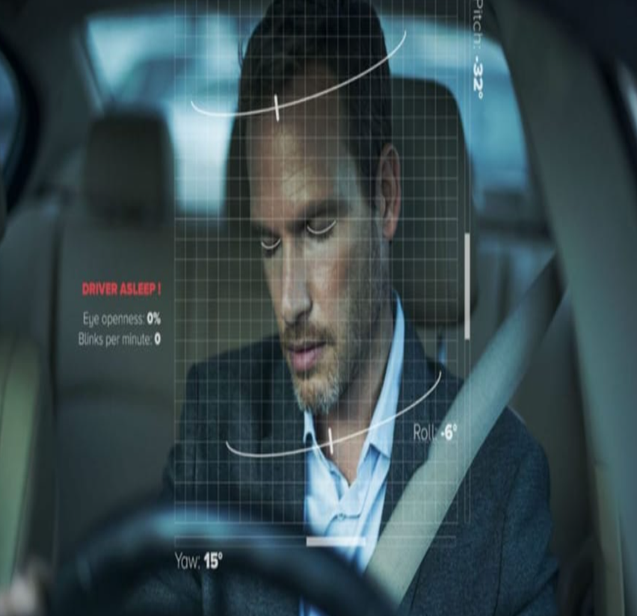
OBJECTIVES
Design and implementation of a hybrid CNN/LSTM model with an Autoencoder as feature extractor.
Assess the model’s accuracy using a range of performance measures.
Enhance the model performance.
Compare the suggested system with current methods.

Slide 5
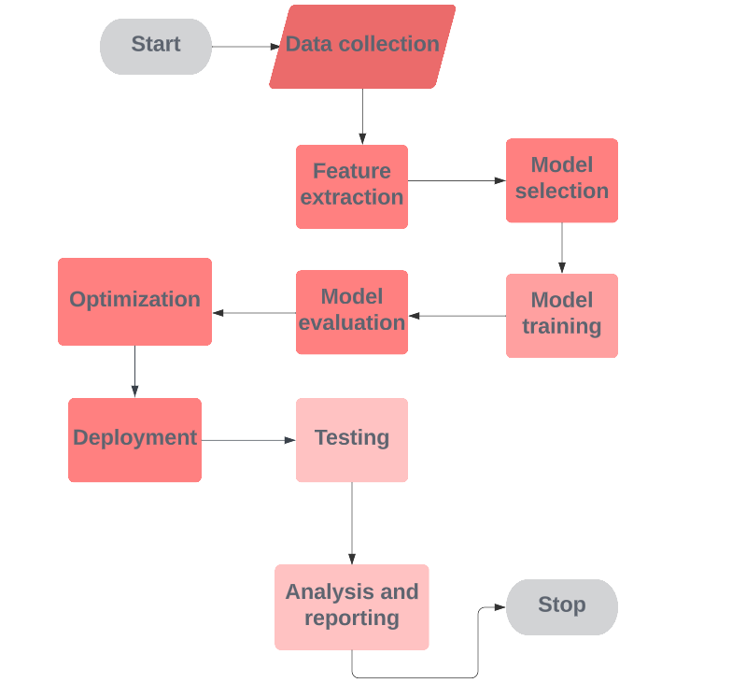

Project Flow
Drawn with Lucid Chart

Slide 6
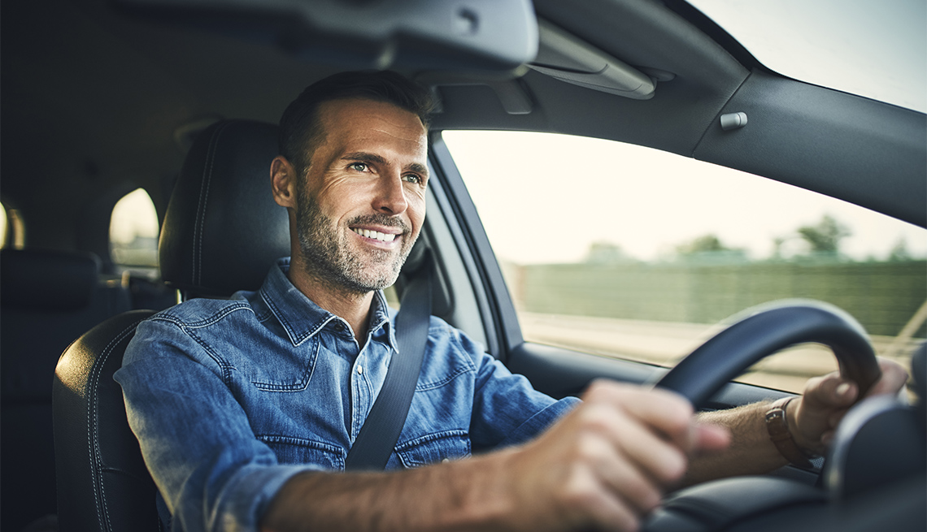
THANK YOU
STAY SAFE

